Slide 1

Online Shop Management
[E-Commerce]
1

Slide 2
Course Title : Project & Thesis
Course Code : CSE 400A
Prepared By
Md. Rijyan Hossain Sohedul Islam
ID: 152002007 ID: 152002005
Supervisor Name
Md. Ashaduzzaman
2

Slide 3
E-Commerce
E-Commerce → Electronic Commerce
Buying & selling through the internet is said to be E-Commerce.
E-Commerce can be between a business & customers.
3

Slide 4
Safety
Saves Time
Why Useful
24/7
4

Slide 5
Return Policy
Scalable
Why Acceptable
User Friendly Interface with functionalities
5

Slide 6
Most Searched Product
Top Sell Product
Offline
New Feature
Search by Speech Recognition
Request if stock is empty
6

Slide 7
Not Complete Dynamic
Slow
Problems of Existing service
Reviews
7

Slide 8

Some Similar Existing Project
8

Slide 9
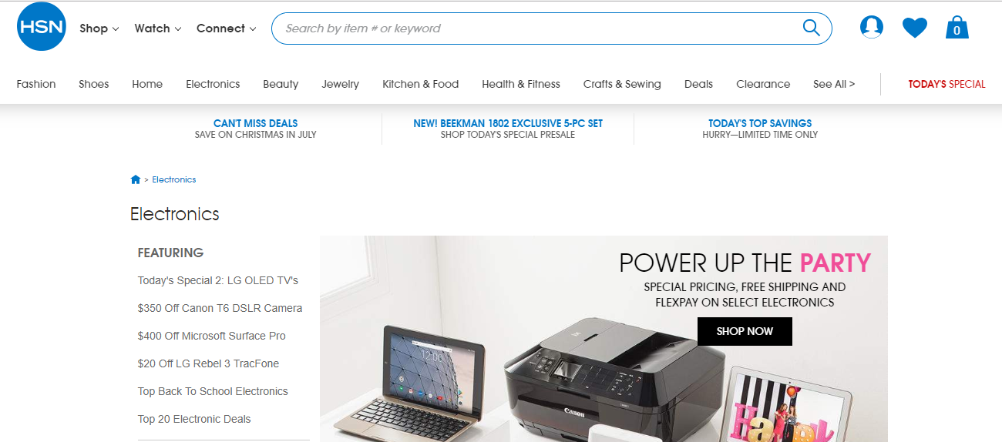
Some Similar Existing Project
9

Slide 10
Our Proposal
We are going to develop a Online shop for selling electronic items.
Will have a return policy for better user experience
Payment Method:
Pay on delivery (Cash)
Pay by bKash / Rocket
10

Slide 11
Tools / Technology
IDE: VS Code
Language: HTML, CSS, JavaScript
Technology: MERN Stack Development
RunTime/Compiler: Node.js
Frameworks: Bootstrap, React.js, Express.js
Database: MongoDB (NoSQL)
Design: MVC Pattern
Google, Facebook APIs
10

Slide 12
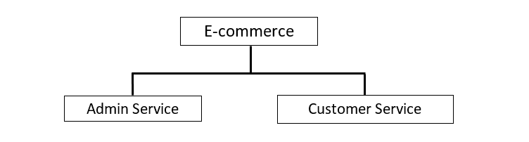
Features / Functionality
11

Slide 13
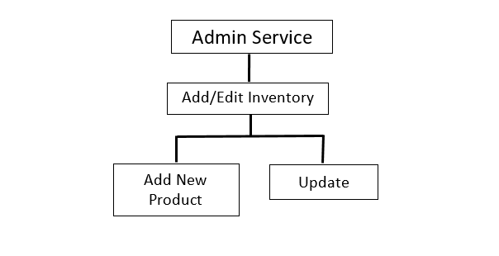
Features / Functionality
12

Slide 14
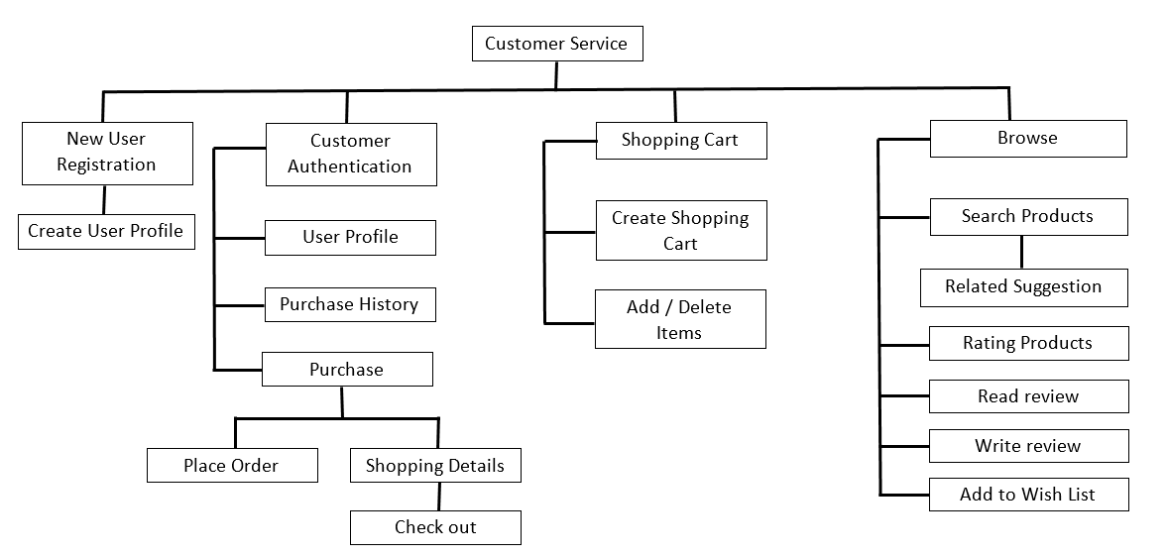
Features / Functionality
13

Slide 15

14

Slide 16
Thank You
15

